Slide 1
Level 4 Project
Week 13
(Week 12/13 Recap)

Slide 2
Original plan for weeks 12 and 13
Week 12
Finish evaluating best pre-processing method
Tune autoencoder for dimensionality reduction
Evaluate t-sne clustering
Week 13
Visualise t-sne → changed visualisation function + gif function
Explore methods of segmentation:
k-means clustering (2 clusters)
contour finding
structure similarity
blob detection
Top-hat transformation?
Submit status report

Slide 3
T-SNE visualisation in GIF
Not pictured here because of the size of the GIFs
https://drive.google.com/file/d/1SKd2M9Kv6xKsrUxS2M0NC2KuRyV2Ebf6/view?usp=sharing

Slide 4
Clipping DMSO dataset values under 255
low_clip function transforms <255 values to 0
max_normalise function normalises according to max pixel value of the image
Performance is very similar to previous, if not slightly worse in terms of loss

Slide 5
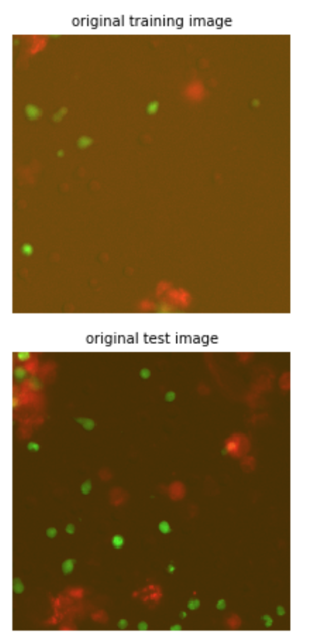
Combining tcell, dc DMSO images into RGB image
Red channel = dendritic cell
Green channel = tcell
Blue channel = empty

Slide 6
Summary of all models and outputs
Available at: https://github.com/leonore/l4-project/blob/master/src/cell_autoencoder.ipynb
The important things are the titles and the images
While doing this I found out that the issue I had been having with poor reconstructions all this time was because unclear documentation in Numpy made me think I was making copies of the dataset, but I was really reusing the array every time.
So normalisation over normalisation etc. resulted in a lot of loss.
So even 16-bit normalisation gets *some* kind of result but max normalisation still works a lot better.

Slide 7
What I learned from the summary
Always make a new copy of the data
Combining the images in a RGB image seems to work better for clustering.

Slide 8
Image segmentation with K-means
Works very well for getting masks and direct overlap
Overlap is shown in yellow below, calculated with intersection over union

Slide 9
Overlap results with K-means
Quite spread out, but the mean is maximum for ConA
This is in line with what Hannah has told me about ConA driving the most interaction at 60-80% overlap
Calculated % is much lower here though
Sample size issues: both unstimulated and ConA have 9400 samples, but OVA has 1200
Results are consistent with a same-sized subsamples:
We get more 0% interaction with no stimulation, then OVA, then ConA

Slide 10
Investigating structural similarity index
Doesn’t seem to be a very promising technique as an interaction detection technique as they are all quite structurally similar (blobs of cells, lots of background)

Slide 11
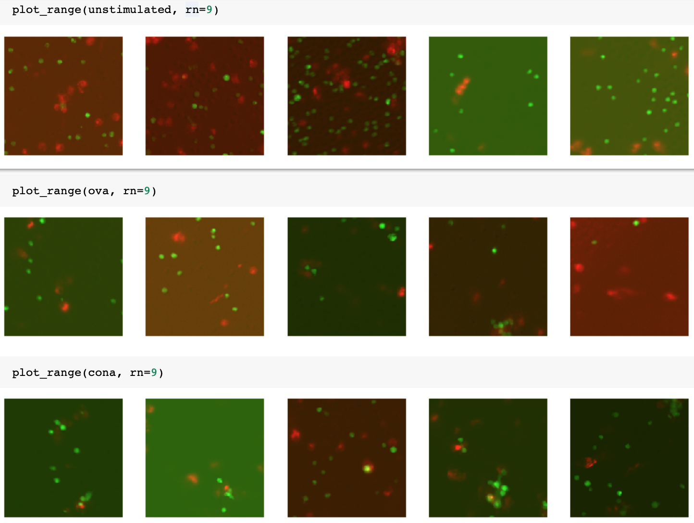
Combining K-Means + autoencoder
Making a dataset with the images, but their background is masked out with the masks obtained through K-Means
This is because as you can see, the images seem to be very dependent on the shade of the background

Slide 12
Combining K-Means + autoencoder
As you can see the shades are much more consistent.
And the clustering results are much more promising:
One main cluster but very tight “unstimulated” cluster within it
Some outliers which can come from empty images, images that suffer from the pre-processing, etc.

Slide 13
Combining K-Means + autoencoder
t-sne
UMAP

Slide 14
Next steps
I want to re-investigate using a UNet like structure for detecting masks in unseen images and be able to differentiate between dendritic cells and t-cells.
It seems that this is Hannah mentioned at the beginning of the semester: how software struggles with dendritic cells, but not t-cells as they are blobs.
What do you think?
Full plan is in status report

